Slide 1
Oral Cancer
By: Gabriella Gallina, Jasadee Marquez, Jordan Reaser, Christina Rudderow

Slide 2
What is Oral Cancer?

Slide 3
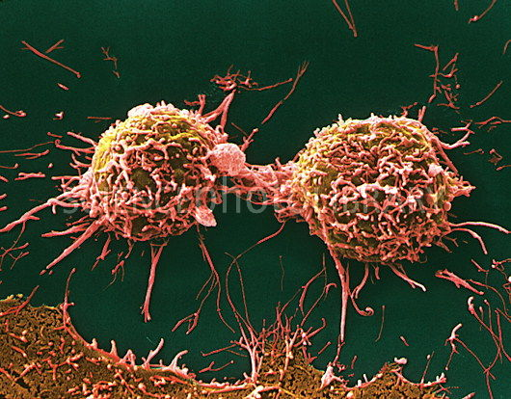
Oral Cancer- the uncontrollable growth of cells in the oral cavity(mouth) that invade and cause damage to surrounding tissue

Slide 4
Risk Factors

Slide 5
Smoking
Excessive consumption of alcohol
Smokeless tobacco users
Family history of cancer
Excessive sun exposure

Slide 6
Location

Slide 7
Lips
Upper and lower jaw
Gums
Cheeks
Tongue
Throat

Slide 8
Symptoms

Slide 9
Non healing sores in mouth or on lips
Loss of teeth
Bleeding
Chewing/swallowing problems
Lumps, earaches, and bumps
NOTE:
A sore or lump on lips or tongue limits the amount of movement required for proper sound of P/B/I/R and M’s
Also makes it harder to hold food in mouth

Slide 11
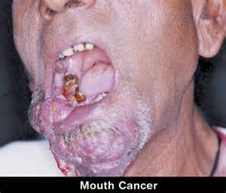

Slide 12
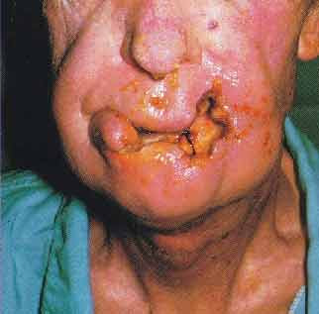

Slide 13
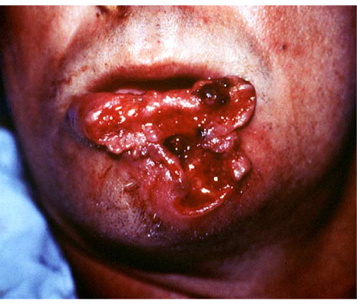

Slide 14
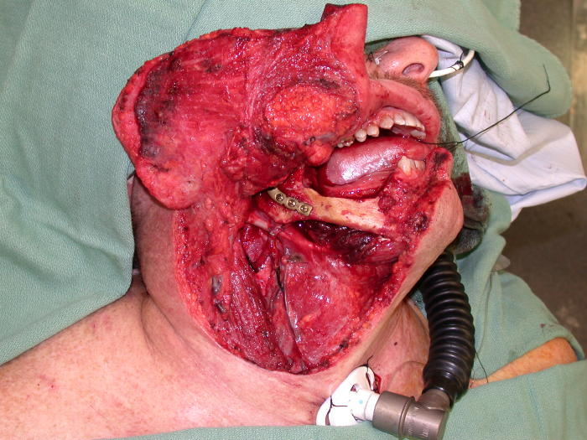

Slide 17
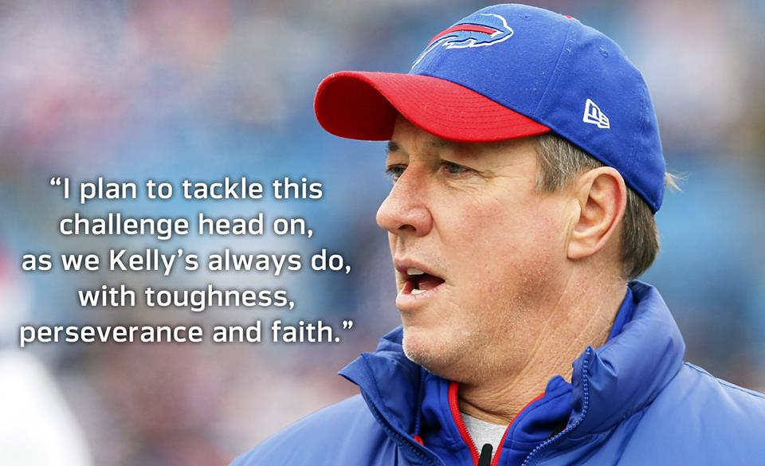
Who Is This?

Slide 18
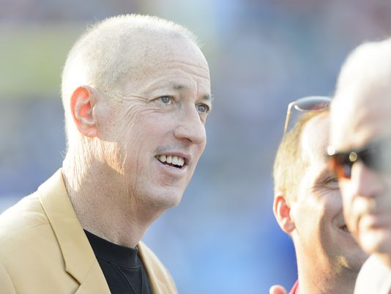
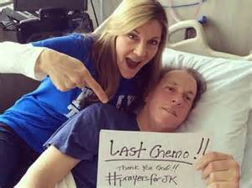

Slide 19
Sources
http://www.oralcancerfoundation.org/facts/#sthash.PVlAgT1w.dpuf
http://www.asha.org/public/speech/disorders/oralcancer.htm
http://www.webmd.com/oral-health/guide/oral-cancer

